Slide 1

THE MUGHAL EMPIRE
BEGINNING IN THE YEAR 1526 …..

Slide 2
WHO WERE THE MUGHALS?
THE MUGHALS WERE DESCENDANTS OF TWO OF THE GREATEST CONQUERORS OF THE WORLD DURING MEDIEVAL PERIOD – GHENGHIS KHAN ( RULER OF THE MONGOL TRIBE) FROM THEIR MOTHER’S SIDE;
AMIR TAIMUR LONG OR TAIMUR LANE FROM THE FATHER’S SIDE.

Slide 3
FROM WHERE DID THE MUGHALS OR MONGOLS ORIGINATE FROM?
THE DYNASTY ORIGINATED BEYOND THE HINDUKUSH ,CENTRAL ASIA. THEY WERE OF TURCO-MONGOL ORIGIN FROM AN AREA WHICH IS A NOW PART OF MODERN-DAY UZBEKISTAN .

Slide 4
WHY DID THEY OPT FOR INDIA?
Fabulous Wealth of India
Legal right
Limited Income of Kabul
Fear of Uzbek Invasions
The Political Condition of India
Invitation from the Lodhi Ruler
Babur himself was over ambitious

Slide 5
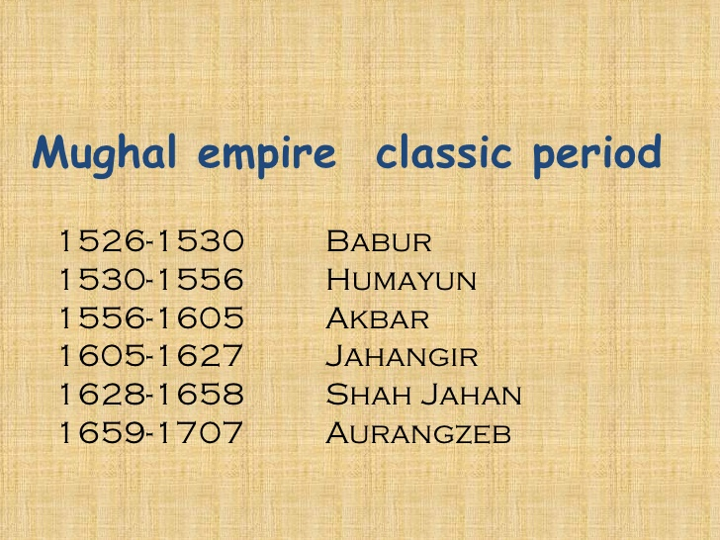
The Mughal Period

Slide 6
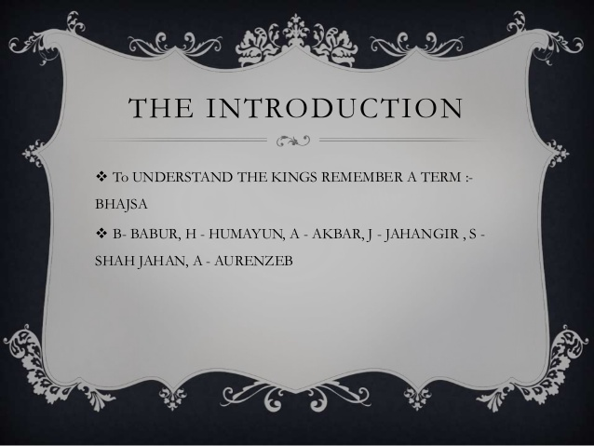
MNEMONICS
SOMETHING TO AID MEMORY ; ART OF IMPROVING MEMORY

Slide 7
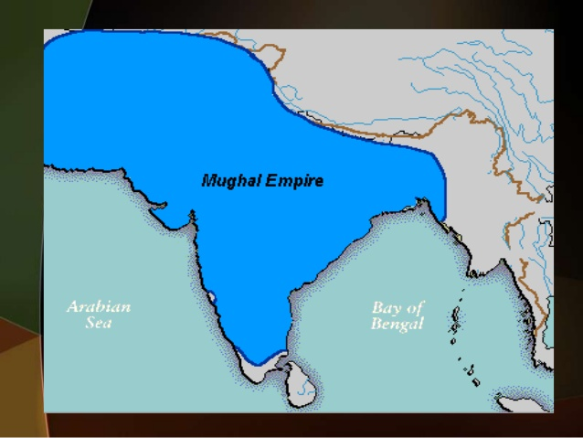
The expanse of the Mughal Empire
Given in blue – this was the Mughal empire at the peak of its extent

Slide 8
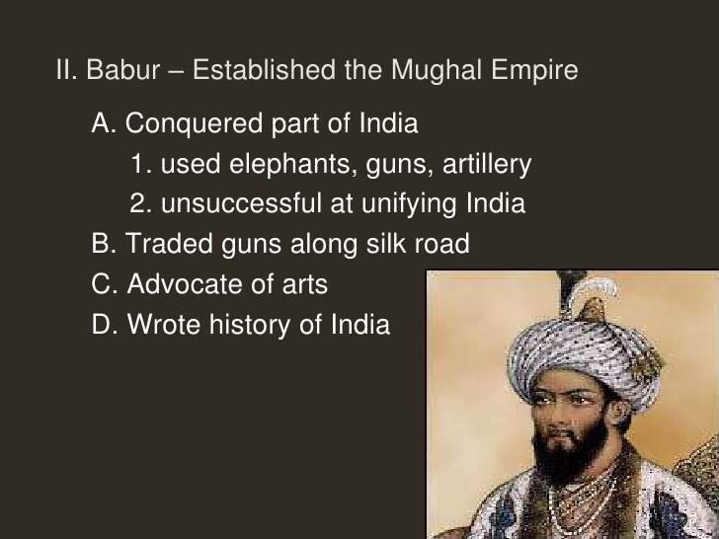
The founder – Babur(1526-1530)

Slide 9
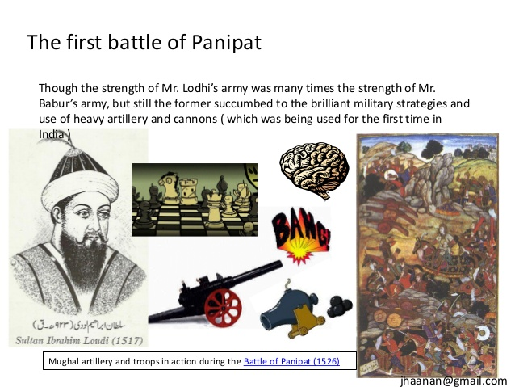
The most important event of his rule

Slide 10
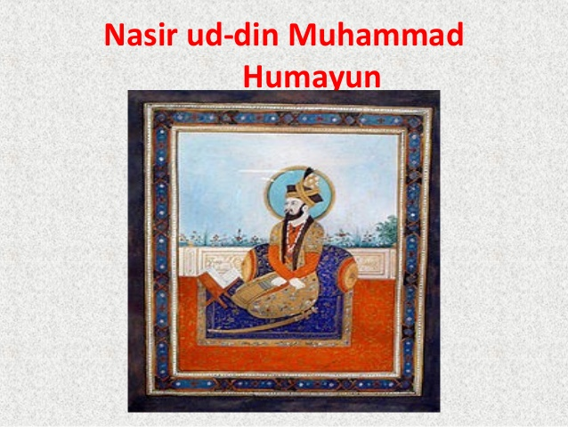
THE SECOND GREAT MUGHAL RULER- HUMAYUN

Slide 11
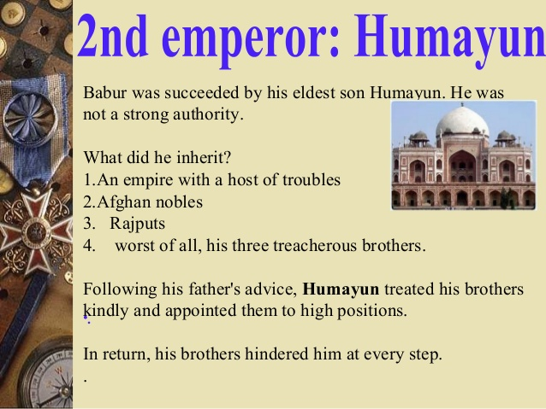
THE SECOND GREAT MUGHAL-HUMAYUN

Slide 12
TO BE CONTINUED FURTHER…………

